Slide 1
Continuous Integration, Delivery, Deployment, and DevOps
Agile Software Development
Eric Knauss
eric.knauss@cse.gu.se

Slide 2
Agenda today
Continuous X:
Integration, Delivery, Deployment, and DevOps – Terminology and Origin
In the context of Large-Scale System Development
Continuous Deployment Practices
Testing Strategies for Continuous X for Embedded Systems
The Role of Value, Features, and Requirements
Key takeaways:
Fundamental
Agile values
Testing
Advanced
User value
System knowledge
Architecture

Slide 3
Definition of Continuous X
Part 1: What is Continuous Integration (Delivery, Deployment) and why is it important

Slide 4

Continuous Integration: Key ideas
Big Bang integration very costly
Immediate feedback important
Fowler: Mindset more important than technology
Integrate and test code every few hours (1 day at the most)
Dedicated machine helps
If Machine is free: pair sits down, integrates their changes, tests, and does not leave before 100% of tests run
Implies: small agile team

Slide 5
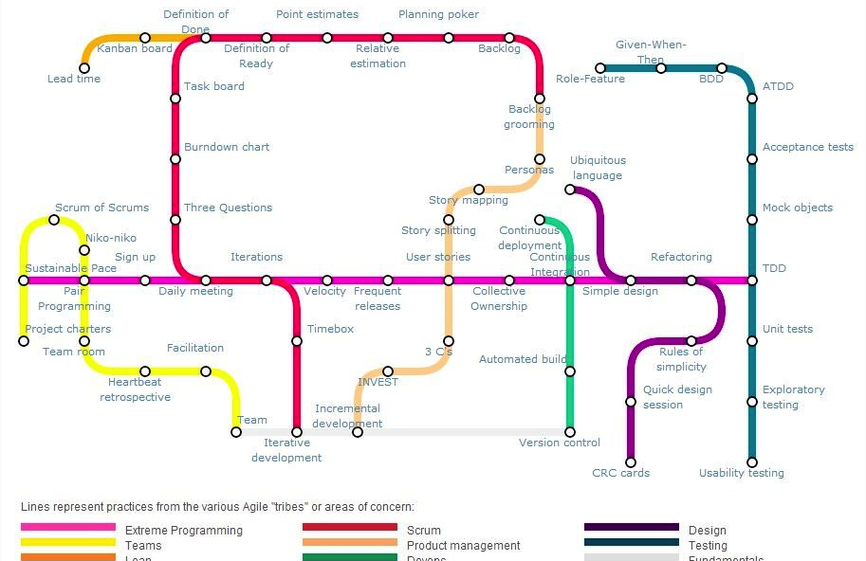
Origin: Agile Practice
https://techblog.betclicgroup.com/wp-content/uploads/2013/12/agileSubwayMap2.jpg
Also check: http://guide.agilealliance.org

Slide 6
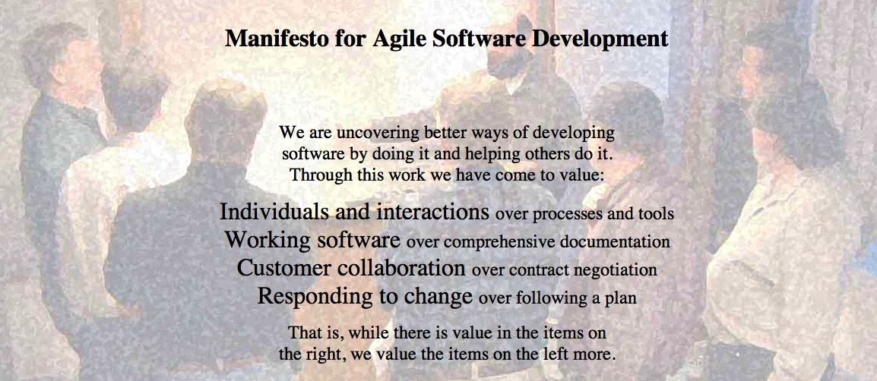
Agile Manifesto
http://agilemanifesto.org
Began as a provocation: Plan-driven development did not safe the Software world…
Now a very serious movement, well adapted in industry.
There are a couple of established agile methods: How to integrate these values in everyday software development

Slide 7
What is agile? What is not?
Agile – a compendium of ideas
Applied by number of methods (incl. XP, Scrum, Kanban, Lean Software Development)
Core characteristics defined through
Values: General assumptions framing the agile view of the world
Principles: Core agile rules, organizational and technical
Roles: responsibilities and privileges of the various actors in an agile process
Practices: specific activities practiced by agile teams
Artifacts: tools, both virtual and material, that support the practices
[Mey2014]

Slide 8
Agile Values
Redefined roles for developers, managers, and customers
No ”Big Upfront” steps
Iterative development
Limited, negotiated functionality
Focus on quality, understood as achieved through testing
[Mey2014]

Slide 9
Agile Principles – Revised list (according to [Mey2014])
Organizational
Put the customer at the center.
Let the team self-organize.
Work at a sustainable pace.
Develop minimal software:
Produce minimal functionality.
Produce only the product requested.
Develop only code and tests.
Accept Change
Technical
Develop iteratively:
Produce frequent working iterations.
Freeze requirements during iterations.
Treat tests as a key resource:
Do not start any new development until all tests pass.
Test first.
Express requirements through scenarios.
6. Reflect regularly and improve continuously!

Slide 10
Why to do Continuous Integration
Some evidence that
SW quality can be significantly improved
SW development can be significantly accelerated (time to market)
Likely that
CI is not cheaper than traditional development
CI has positive impact on flexibility
→ Tendency to apply at scale and for systems

Slide 11
Organizational Categories
Enterprises: software supports internal processes and external services (e.g. banks, insurance companies)
Product oriented organizations: develop software or software intensive products that are not deployed directly by the development teams
Service companies: develop software that is hosted and deployed directly by the developing team
Matthew Bass (CMU)

Slide 12


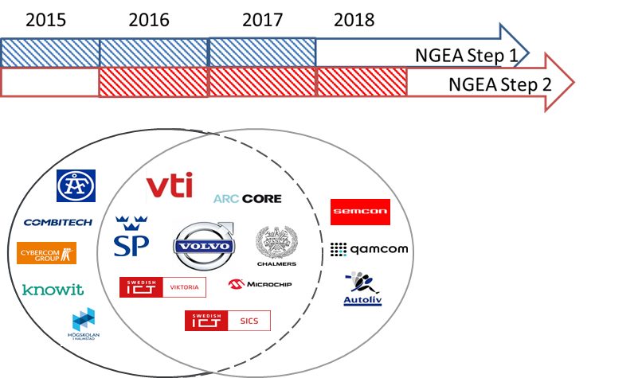

Insights from Research Projects
Software Center aims to develop a strategic partnership with partner companies to significantly accelerate their adoption of novel approaches to software engineering
http://www.software-center.se/partners
NGEA prepares the next generation of electrical architecture to increase flexibility, decrease development lead time, and increase the ability to develop complex systems and system of systems. These goals will be reached by consequently facilitating continuous integration, delivery, and deployment.

Slide 13

STAIRWAY TO HEAVEN
The Stairway to Heaven Model describes the stages that companies evolve through when adopting novel approaches to software engineering
Companies move through a predictable and repeatable pattern over time when evolving software engineering practices
Each transition has business, architectural, process and organizational implications
The higher up the stairway an organization climbs, the more organizational units are affected
H.H. Olsson, H. Alahyari, J. Bosch, Climbing the"" Stairway to Heaven --A Mulitiple-Case Study Exploring Barriers in the Transition from Agile Development towards Continuous Deployment of Software, 38th EUROMICRO Conference on Software Engineering and Advanced Applications (SEAA),, pp. 392-399, IEEE, 2012.
…
…
For more information please contact jan.bosch@chalmers.se

Slide 14



Context
This is joint and ongoing work
Synergies between NGEA and Software Center Project 1 “Implications of Continuous Deployment”
Based on group interviews with 6 companies + cross-organizational workshops for consolidating results
Research goal:
Many definitions, many concepts (Continuous Integration, Continuous Delivery, Continuous Deployment, …)
Understand which aspects are important in practice
Agree on shared language = Common Understanding
Agneta Nilsson
Magnus Ågren
Rogardt Heldal

Slide 15
Continuous Integration
From Literature
Integrate new or changed code with the mainline codebase at frequent time intervals
Integrate / Test
Sufficient quality of codebase
One Mainline / Several
As long as each carry customer value
Frequency Weeks / Days / Instant
Why do we integrate – to get feedback
Integrate and test new or changed code with a codebase to enable feedback whenever we want
From Interview
Synthesis

Slide 16
Continuous Deployment
The ability to release software whenever we want
Release and Install in running / Deliver
Higher quality level of codebase
Strong quality assurance
The ability to release and install software in running system whenever we want
Otherwise: Continuous Delivery

Slide 17
Working Definitions for this lecture
Definitions and Characterizations
Continuous Integration: Ability to integrate and test new or changed code with a code base, which carries customer value, whenever desired to enable feedback.
Continuous Delivery: Ability to release customer and/or product value to a target environment whenever desired to enable feedback.
Continuous Deployment: Ability to release and install customer and/or product value into a running system at customer site whenever desired to enable feedback.
DevOps: Setup where cross-functional feature teams work closely with operations teams to facilitate continuous deployment

Slide 18
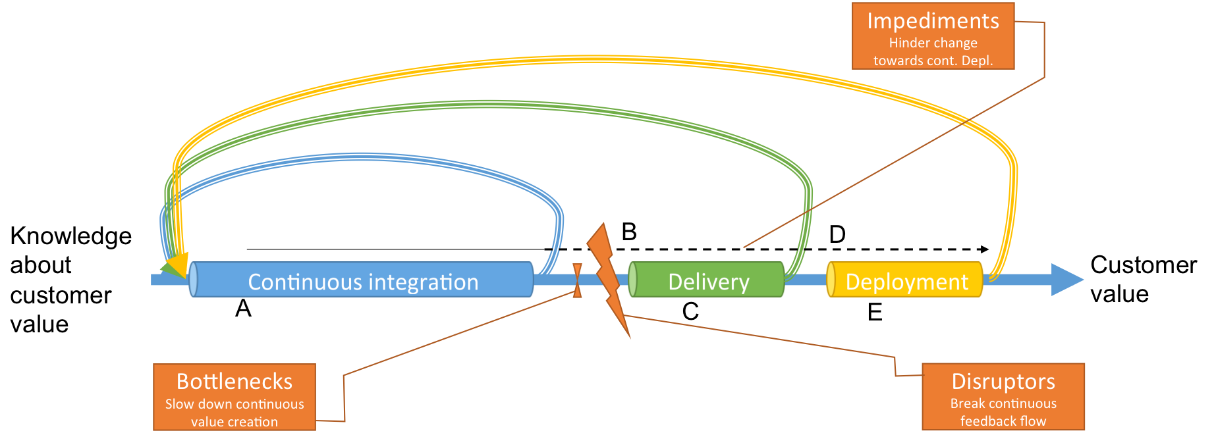
Some conceptual view

Slide 19
Something in between…
Continuous Integration often on team level
Continuous Deployment implies the whole organization to work in a continuous way
Enterprise Continuous Integration [Ståhl and Bosch 2015]
Continuous X includes a number of dimensions

Slide 20
Current work
Systematic Literature Review to understand different dimensions of these terms
Organizational scope
Other dimensions:
Managing architecture, requirements, business drivers
Transparency
Testing
Practical scope: Vision, Constructive, Experience
-- Customer
-- Company level
-- Department level
-- Team level
Integration --
Delivery --
Week --
Deployment --
Day --
Hour --
Technical scope
Feedback speed

Slide 21
Continuous Deployment
Rahman, A. A. U.; Helms, E.; Williams, L.; Parnin, C.: Synthesizing continuous deployment practices used in software development. In: Proc. of Agile Conference; pg. 1-10; DOI: 10.1109/Agile.2015.12; Washington DC, USA. 2015
Practice | Description
Automated deployment | Making software available to end-users automatically
Automated testing | Automated techniques to perform various testing activities (test case management, test monitor and control, test data generation, test case execution, …)
Code review | Requires developers to present software changes for comment and approval
Dark launching | Deploying software changes by keeping the functional aspects of the software changes hidden to end-users
End-user comm. | Communicating with end-users in order to receive feedback and gather requirements about the software of interest
Feature flag | (= feature toggle or feature flipper) is a technique that facilitates in triggering a specific branch amongst several branches of the software to enable or disable (parts of) features
Intercommunication | Sharing all necessary development and deployment information amongst software team members
Monitoring | Collecting deployment related information, producing appropriate performance metrics, and reporting them in an appropriate format
Software repository | Software library that contains all the necessary software artifacts. We must distinguish branch and trunk shipment.
Staging | Executing a specific set of techniques by the adoptee after software changes are written, tested, and before software changes are deployed to end-users
Dogfooding | When a software team uses its own software as part of their software development
Gradual rollout | Deploying software changes step-by-step to fractions of end-users

Slide 22
Testing Strategies for Continuous X for Embedded Systems
Part 2:
Automation and Dynamic Optimization of Test Suites

Slide 23
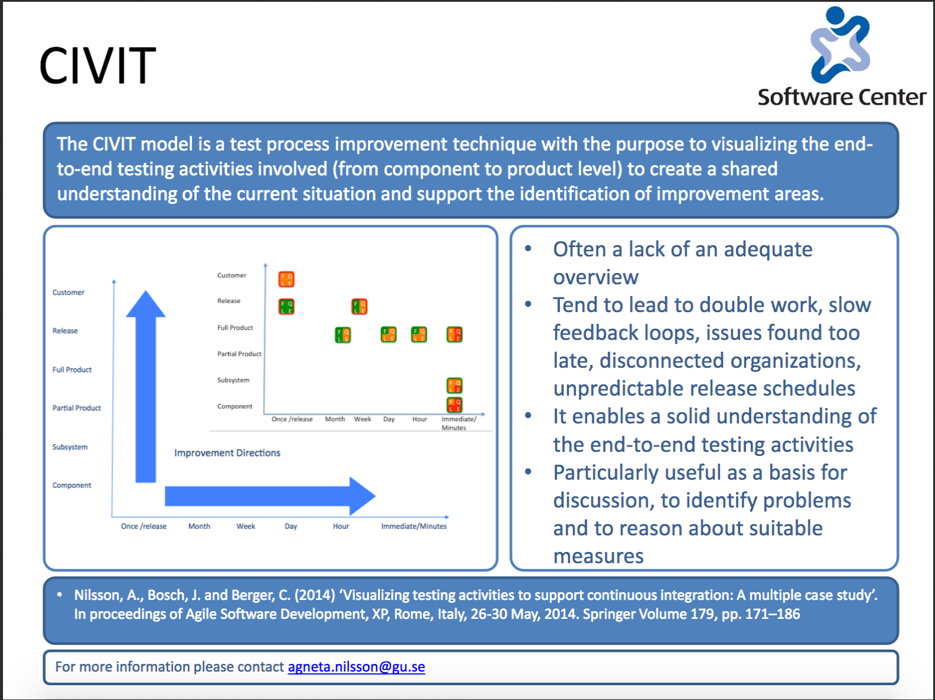

Slide 24
Example Civit model

Slide 25
The CIVIT Model
Customer
Release
Full Product
Partial Product
Subsystem
Component
Improvement Directions
Once /release Month Week Day Hour Immediate/Minutes

Slide 26
Legend
Complete coverage
Significant testing 70% < coverage < 95%
Partial testing 30% < coverage < 70%
Some testing but less than 30% coverage
F Functional requirements
Q
Quality requirements
No testing of this type at all
Coverage for each type of testing
F
Q
L
E
Level of test automation
L
Legacy
functionality
E Edge cases
Fully automated
Significant automation, between 70 and 95%
Partial automation, between 30 and 70%
Some automation, less than 30%
No automation at all

Slide 27
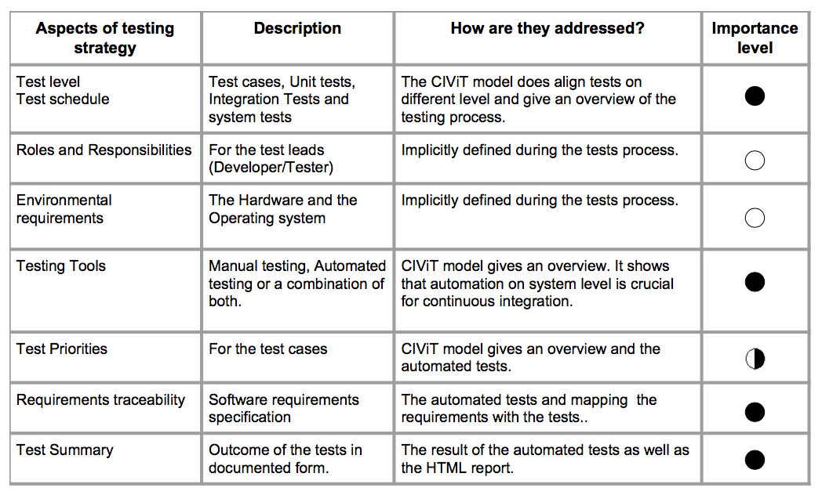
Testing Strategies for CI
+ Test lifecycle
Haritha Gangineni Sarah Jamil: Testing Strategies to Support Continuous Integration for Complex Systems. Master’s thesis in Software Engineering, Chalmers and University of Gothenburg, 2016

Slide 28
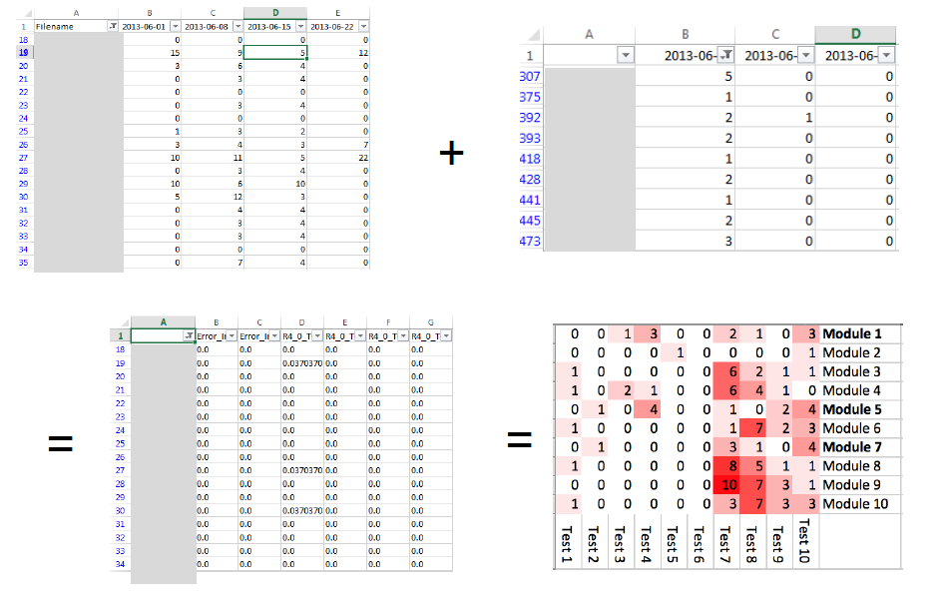
CCTS
The Code-Churn Test Selection model identifies the most optimal test suite based on the changes in the source code
Reduction of test suite by 73% without any loss of effectiveness
Can speed up continuous integration and reduce cycle times
Can be applied at all test levels
E. Knauss, M. Staron, W. Meding, O. Söder, A. Nilsson, M. Castell, “Supporting Continuous Integration by Code-Churn Based Test Selection”, Proceedings of the 2nd International Workshop on Rapid and Continuous Software Engineering (RCoSE), ICSE 2015, Italy.
…
For more information please contact eric.knauss@cse.gu.se, agneta.nilsson@cse.gu.se and/or miroslaw.staron@cse.gu.se

Slide 29
Why test prioritization & selection?
Large product, many integration tests
Days or even weeks to run them all
Continuous X = quick feedback
“We have 2h. Run the most important tests.”
“As a cross-functional team, I want to run important integration tests regularly so that integration will be smooth.”
“As an integration tester, I want to give feedback to developers as quickly as possibe.”

Slide 30
Recommending tests (idea)
Prioritize tests based on heatmap
Collect which modules/components where changed
Sort tests by frequency that the failed in connection with collected changes
Cut off list by some criteria
Notes:
----- Meeting Notes (24/10/14 13:57) -----
look at flip flopping as well

Slide 31
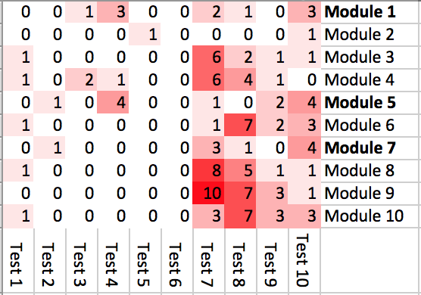
Principle 1
Starting from a heatmap…
…we can understand test efficiency

Slide 32
Principle
We can prioritize these tests (=sorting)
…and select tests.

Slide 33
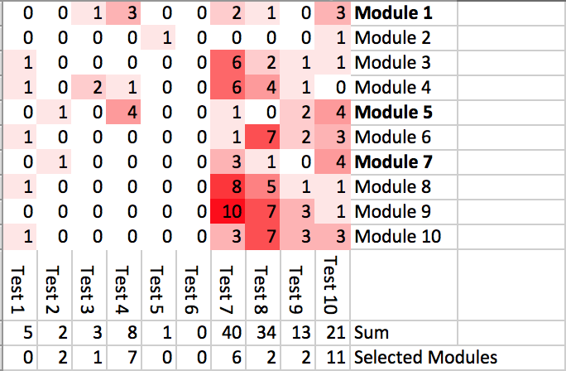
Principle 2
If we know the modules that have recently changed…
…we can characterize test efficiency specifically for these modules

Slide 34
Principle 3
Perhaps a test is not likely to fail, but it would be strategically problematic. Therefore, we can also take into account business value

Slide 35
Applied to realistic data
Optimize the last 13%? But might be larger in your case!
Not a selection problem
Principle 2: Use historical data on code change
Linlin Wang: Implementation and Evaluation of an Automatic Recommender for Integration Test Cases. Master thesis at Chalmers, Gothenburg, Sweden, supervisor: Eric Knauss, examiner: Miroslaw Staron. 2015
Principle 1: Use historical data on test execution
918 Tests, history over one year (255 test executions)
Did not fail last year → don’t run daily

Slide 36
Applied to realistic data (ongoing)
Principle 1: Use historical data on test execution
Did not fail last year → don’t run daily
“You can do that tomorrow!”
Principle 2: Use historical data on code change
Optimize the last 13%? But might be larger in your case!
Still good potential for speedup.
If you apply Principle 2:
Only 6% of the tests that fail were not recommended
Only 23% of the tests we did recommend don’t fail
Overall: Moderate strength recommendations (MCC > 0.2
On average/for on third of the tests: Strong (MCC > 0.4) recommendations

Slide 37
The Role of Value, Features, and Requirements
Part 3:
How to support flexibility, facilitate feedback, and maximize learning

Slide 38
Requirements now and then
= “Stakeholder needs/properties a system should fulfill/exhibit”
V
Then
Requirements a “waterfall phase” with specialists

Slide 39
Mind the gap: Challenges with RE in Large-Scale Agile Systems Development
Kasauli, R.; Liebel, G.; Knauss, E.; Gopakumar, S.; Kanagwa, B.: Requirements Engineering Challenges in Large-Scale Agile System Development. Submitted to RE conference, 2017

Slide 40
Mind the gap: Challenges with RE in Large-Scale Agile Systems Development
Requirements engineering
Define tests
Inform developers
Document for maintenance
V
Scope of agile development
To be supported by:
Communication and Knowledge Management
Shared Understanding of Value
Customer Value to Team
Meaningful User Stories
Feedback and Clarification
Time for invention and planning
Impact on infrastructure
Component vs. System Thinking
Agile Islands in Waterfall
Safety critical & agile
Build and Maintain System Understanding
Inform and Synchronize
Create and Maintain Traces
Bridge Plan-Driven and Agile
Complement Tests & Stories
Agile Tool Chain
Role of RE
Reqts: Order, Goal, or Dialogue?
Embrace Change of Reqts?
Reqts as Technical Doc.?
Kasauli, R.; Liebel, G.; Knauss, E.; Gopakumar, S.; Kanagwa, B.: Requirements Engineering Challenges in Large-Scale Agile System Development. Submitted to RE conference, 2017

Slide 41
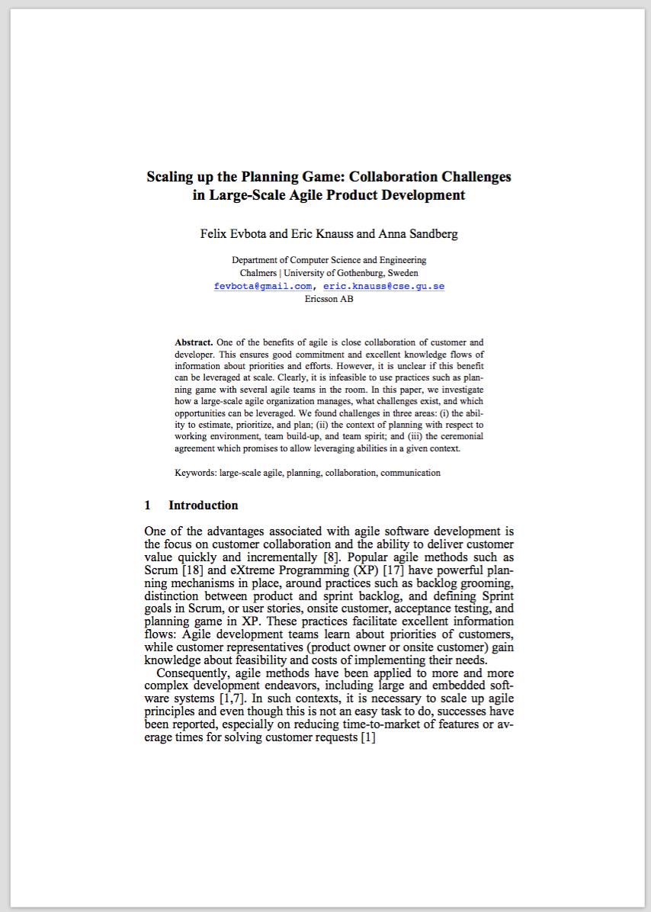
Large-Scale Planning Game
Felix Evbota, Eric Knauss, Anna Sandberg: Scaling up the Planning Game: Collaboration Challenges in Large Scale Agile Product Development. In: Proc. of 17th Int. Conf. on Agile Software Development (XP 2016), Edinburgh, UK, 2016

Slide 42
Understanding Customers and End-users
Large-Scale agile
Agile
Huge distance to customers and end-users
Hierarchy of product owners
Coordinate efforts and dependencies of many teams
Information silos vs. overload
Onsite customer / product owner
User stories facilitate discussions
Planning game to facilitate dialogue between customer and supplier
Cross-functional team offers rich perspective

Slide 43
Findings
Context
Team Spirit
Team Build-up
Work Environment
Research Method
Qualitative Case Study (Ericsson)
10 Semi-Structured interviews with
op. product owner,
line manager,
program leader,
project leader,
release leader,
team leader and
developer
Ceremony Agreement
Estimation Ability
Prioritization Ability
Abilities
Planning Ability

Slide 44
Findings
“[Previously we] estimated on available days in the sprint, that is not a good way because you do not include the unexpected things” [OPO]
“[Sometimes we have a] tester estimating design tasks and a designer estimating test tasks. It is important to know whose estimation should be looked at”. [Line mgr]
Skeptical about estimations
Need to monitor discussions
Estimate tasks that do not fit role
Estimation Ability
Prioritization Ability
Abilities
Planning Ability

Slide 45
Findings
“The challenge is if you have a lot of small backlog you are not in control at all be- cause if you have one common backlog and you decide on a program level, that is how we work [...] if not everything is visible on the common backlog program and only visible in the XFTs backlog then you maybe having a mismatch.” [OPO]
Complex structure of product owners and backlogs
Inconsistencies between backlogs
Lack of transparency
Estimation Ability
Prioritization Ability
Abilities
Planning Ability

Slide 46
Findings
“... we have been working like this for two and half years now, and we are still struggling finding our roles”. [OPO]
”[planning is done by] me as the manager and perhaps with the help of the team leaders sometimes... [unclear] just how much should the team be involved in the planning phase and stuff like that..."
[Line mgr]
Unclear requirements
Unclear role of operational product owner
Involvement of teams
Estimation Ability
Prioritization Ability
Abilities
Planning Ability

Slide 47
Findings
Context
Team Spirit
Team Build-up
Work Environment
Open Space
Disturbing other teams
By-passing operative product owner
“...we have scrum meetings in open office space [...]. You kind of get disturbed when other teams are having their scrum meeting in the open setting. It is better [if] every team has their different rooms.“ [Dev.]

Slide 48
Findings
Context
Team Spirit
Team Build-up
Work Environment
Capabilities of team
Moving team members
Need for broader competence
“[Sometimes] operative product owner has one view and the team has another view [… It] can be a challenge to have the operative product owners to understand what capability a certain team has and he wants much more than they are capable of doing.”

Slide 49
Findings
Context
Team Spirit
Team Build-up
Work Environment
Shared concept of agile
Team maturity
“moving somebody from one team to the other, then you are impacting the team spirit in both teams, you might go back to the team development stage when you get a new team member or lose a new team member”.

Slide 50
Findings
Lack of suitable information channels
Coordination meetings boring or too short
Inadequate anatomy of features
Ceremony Agreement
“The biggest challenge I pick is the coordination of the feature portfolio, [...] on top of getting out features in our program fast and efficient, we need to collaborate on a portfolio basis to align the features over two programs”. [OPO]

Slide 51
Conclusion on Large-Scale Agile Planning
Qualitative Model of what influences agile planning
Overview of key aspects of collaborative planning in large-scale agile development.
Large-scale agile planning not only depends on team abilities or skill, but also on the context in which those teams operate.
Ceremonies and practices on inter-team and inter-product level are currently missing and invite further research.
Outlook: We encourage constructive research to provide improvement for one or several aspects. Our vision is a collection of best, or at least good, practices for each area in out model.

Slide 52
Pre-Study: Adding value every sprint
Kasauli, R.; Knauss, E.; Nilsson, A., Klug, S.: Adding Value Every Sprint: A Case Study on Large-Scale Continuous Requirements Engineering. In: Proc. Of 3rd Workshop on Continuous RE, Essen, Germany, 2017
Benefits
Internal: Increase focus, quality of tests, feedback
External: Reduced distance to customer and risk, increased flexibility, faster learning
Challenges
High effort to maintain quality
Risk of technical debt
Manage long-term perspective
How to check value
Reviews, Sprint dem, Definition of Done, Testing
Suggested improvements
Be pro-active
Component guardians
Focus on process quality
Include team earlier
Improved checks of value
Transparency
Consequence to Continuous Delivery
Impediments
Lack of shared understanding of customer value
Bottlenecks / Disruptors
Distance to Customer
Lack of focus on Sprint goal
Lack of test infrastructure
Catalysts / Enablers
Adding value every sprint
Definition of Done
User stories linked to requirements and tests

Slide 53
Agenda today
Continuous X:
Integration, Delivery, Deployment, and DevOps – Terminology and Origin
In the context of Large-Scale System Development
Continuous Deployment Practices
Testing Strategies for Continuous X for Embedded Systems
The Role of Value, Features, and Requirements
Key takeaways:
Fundamental
Agile values
Testing
Advanced
User value
System knowledge
Architecture

Slide 54
Master thesis
The group maturity and technical debt
Case Study: Agile teams
Group Development Questionnaire (Wheelan).
SonarQube.
Unstructured interview.
Nassiba El haskouri
guselhana@student.gu.se
Notes:
Anounymous , we are going to assess the group and not individuals ,

